Slide 1


Slide 2

PARAMETER TAMPERING

Slide 3

It is the Web-based attack, mainly focusing on certain parameters in the URL.
The Parameter Tampering Vulnerability could lead to the business security threat especially involved in the unauthorized manipulation of another party as well as tampering with the website’s URL.
The attack involves modifying application data, such as user credentials and permissions, price and quantity of products, etc, by manipulating the parameters that are being exchanged between the client and the application’s server.
Parameter tampering is considered to be simple but quite effective.

Slide 4
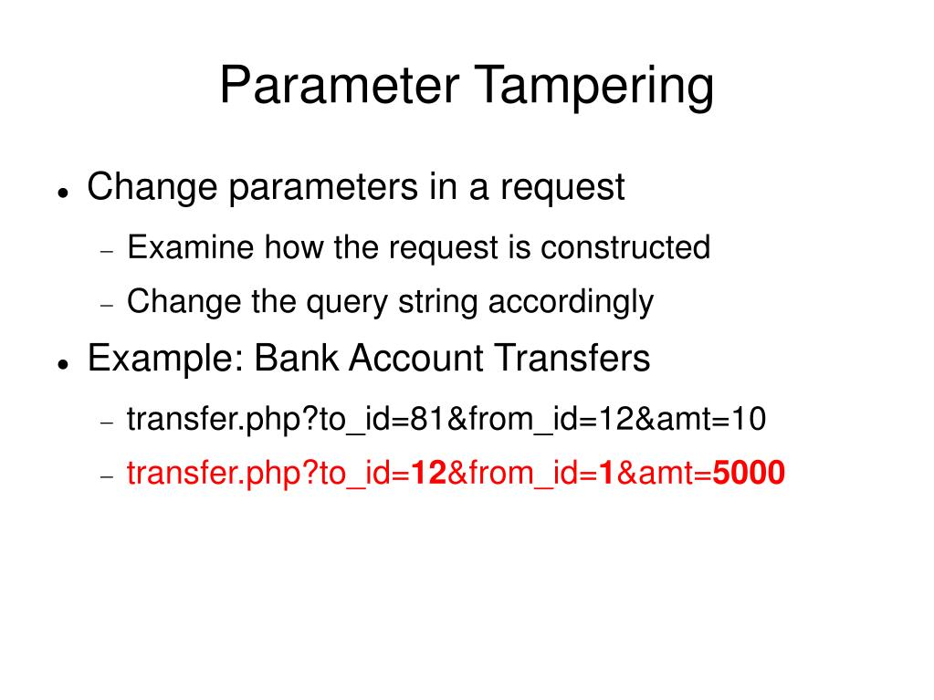

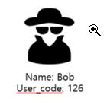


EXAMPLE:

Slide 5
Parameter tampering can often be done with:
Cookies
Cookies
Form fields
Form fields
URL query strings
URL query strings
HTTP headers
HTTP headers

Slide 6
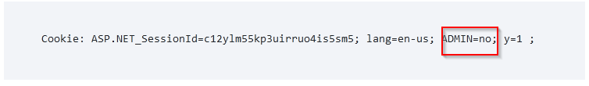
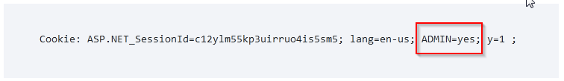
1.Cookie Manipulation
The cookies can be modified by the client and sent to the server with URL requests.
Therefore any malicious user can take advantage of this to modify cookie content.
For example:
The attacker can modify the cookie to:

Slide 7
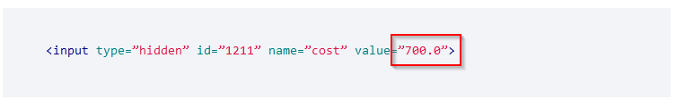
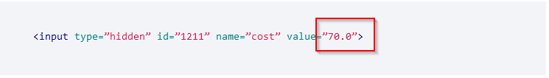
2.Form Fields Manipulation
The form field manipulation occurs when an attacker tries to alter the behavior of a form by illegitimately changing the data sent to the web server.
When a user makes selections on an HTML page, they are usually stored as form field values and sent to the web application.
For example: making a Purchase
An attacker can change this value to 70.00 and it will cause the web application to charge according to the new amount as shown below.

Slide 8
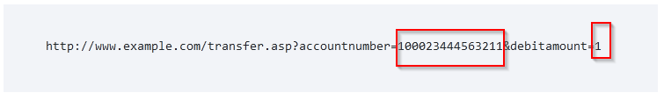

3.URL Manipulation
When the URL passes sensitive values through parameters, the attacker can tamper this query string and perform malicious actions.
For example:
Suppose a web page allows an authenticated user to select one of his/her accounts from a combo box and then debit the account with a fixed unit amount. The following URL is requested:
The attacker can manipulate this URL to credit a higher amount to another account as shown below:

Slide 9
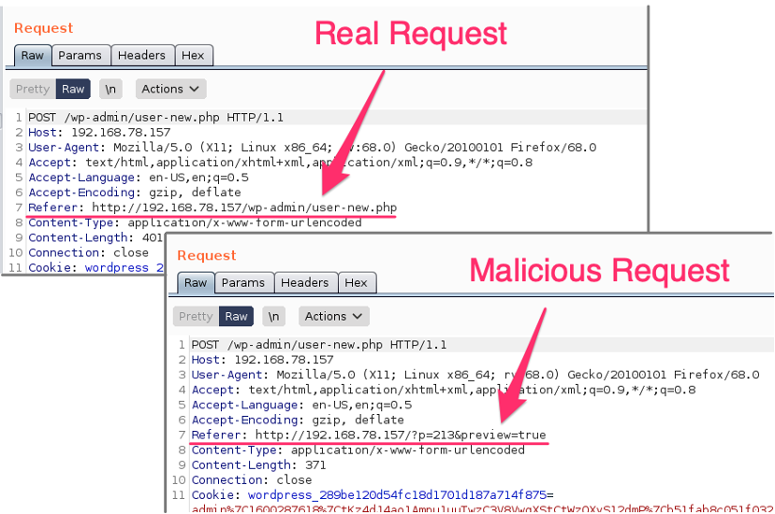
4.HTTP Headers manipulation:
The referrer header, which is included in the HTTP request header, normally contains the URL of the web page from which the request originated.
But sometimes attackers will be able to modify the referrer header to look like it came from the original site.

Slide 10
How to prevent parameter tampering..?
Use a whitelist format for the application’s inputs.
Use web application firewalls for utmost protection.
Encrypt the session cookies to prevent tampering.
If the cookie originated from the client-side, such as a referrer it should not be used to make any security decisions.
Avoid including parameters into the query string.

Slide 11
THANK
YOU

